Slide 1
Linear Regression Regularization
Dr. Sugata Ghosal
CSIS Off-Campus Faculty
BITS Pilani

Slide 2
Session Content
Overfitting of the training data
Effect of Training data size on overfitting
Regularization
Ridge
Lasso
Early Stopping

Slide 3
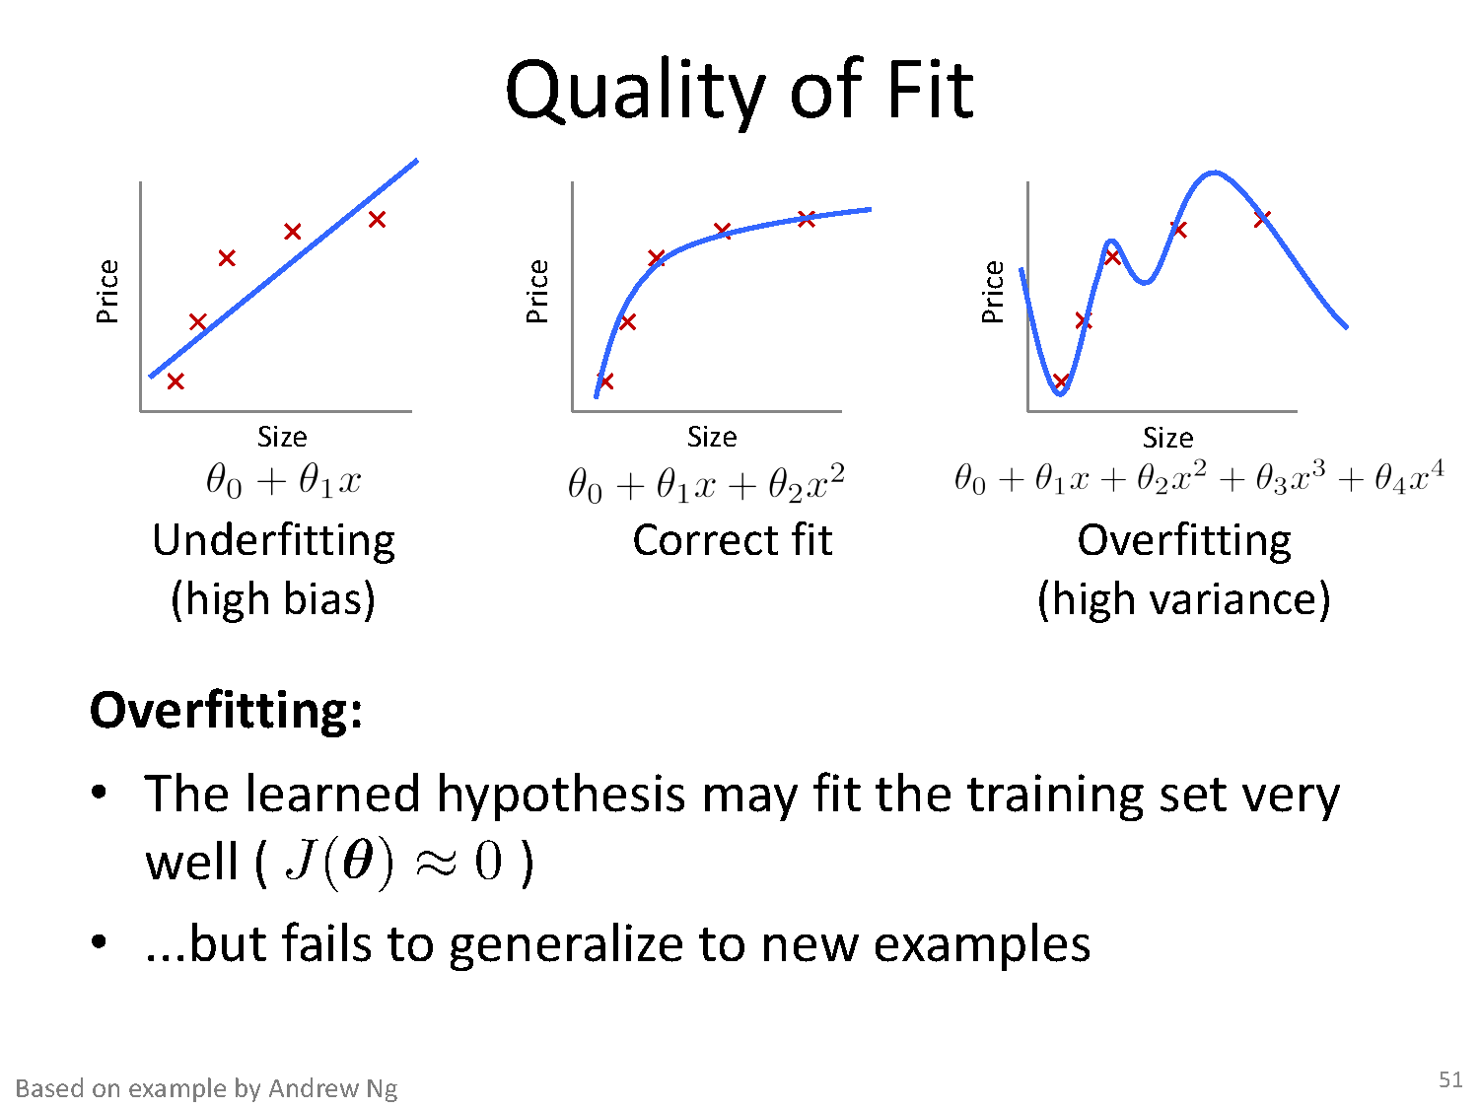
Quality of Fit

Slide 4
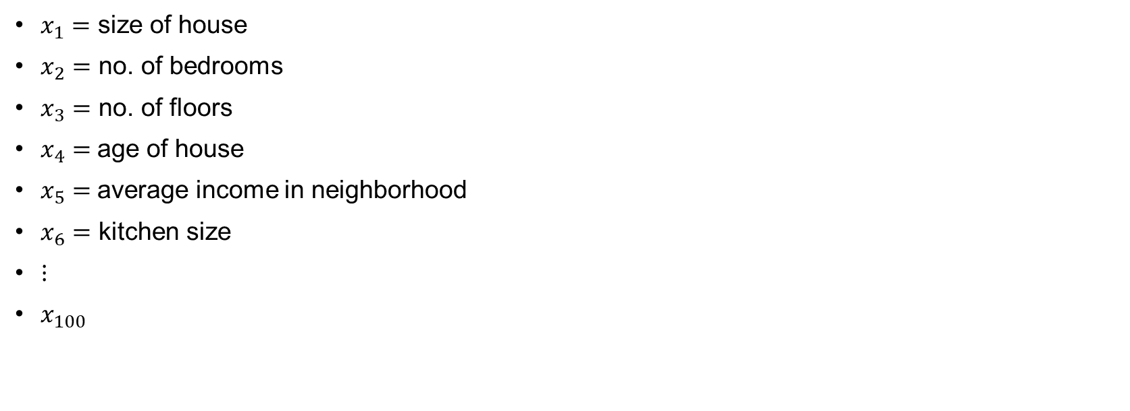
Addressing overfitting
$x_{1}=$ size of house
$x_{2}=$ no. of bedrooms
$x_{3}=$ no. of floors
$x_{4}=$age of house
$x_{5}=$average income in neighborhood
$x_{6}=$ kitchen size
$⋮$
$x_{100}$
Price ($) in 1000’s
Size in feet^2

Slide 5
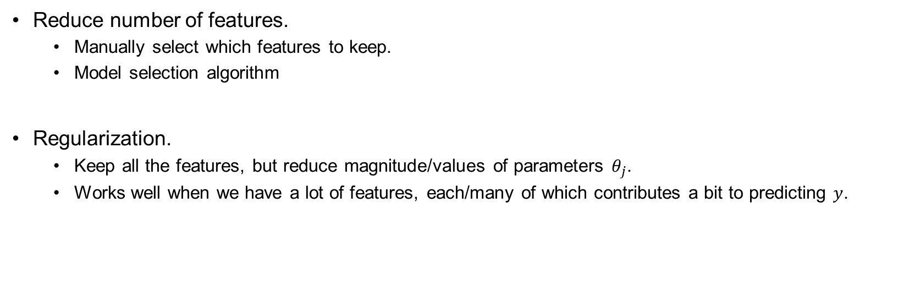
Addressing overfitting
Reduce number of features.
Manually select which features to keep.
Model selection algorithm
Regularization.
Keep all the features, but reduce magnitude/values of parameters $θ_{j}$.
Works well when we have a lot of features, each/many of which contributes a bit to predicting $y$.

Slide 6
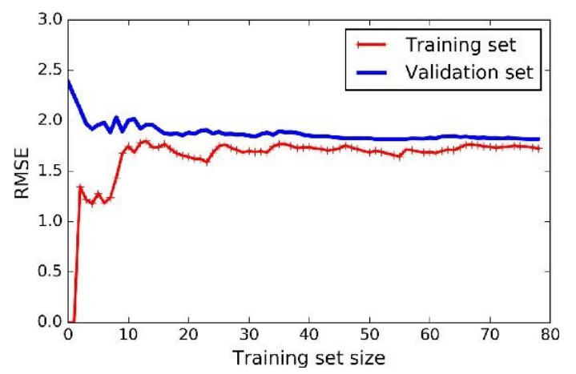
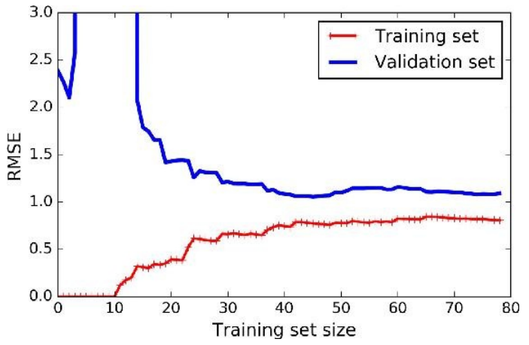
Effect of Training Size on Overfitting
Size of training dataset needs to be large to prevent overfitting
when higher order model is used.
Higher order model
Lower order model

Slide 7
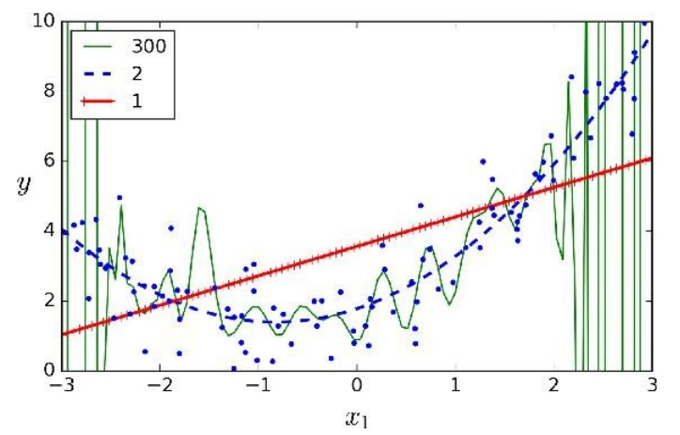
Polynomial Fitting can lead to Overfitting
Underlying target function is quadratic
Linear model results in underfitting with large bias
Polynomial of order 300 results in a large variance

Slide 8
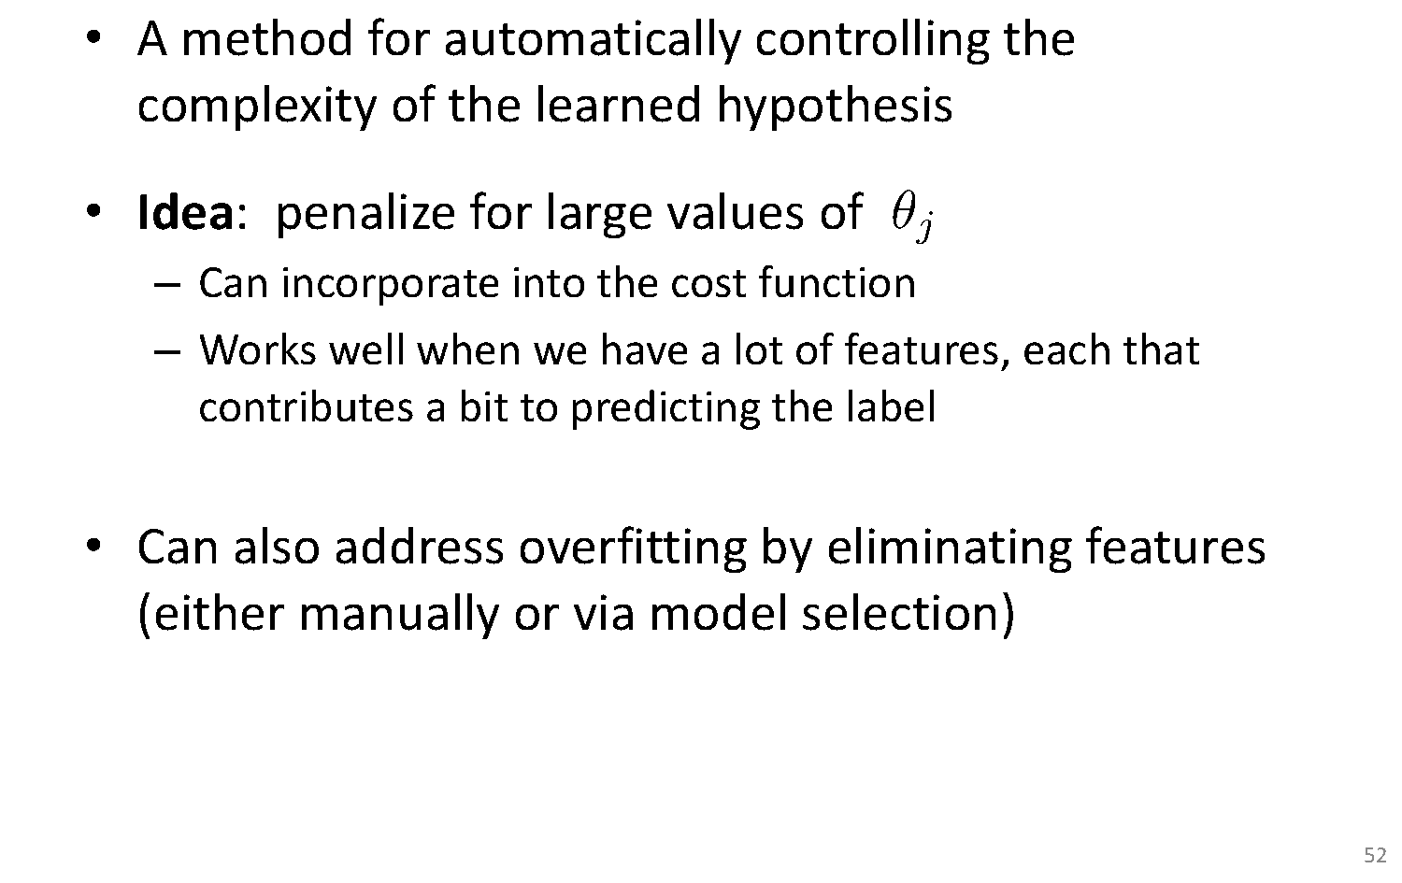
Regularization

Slide 9
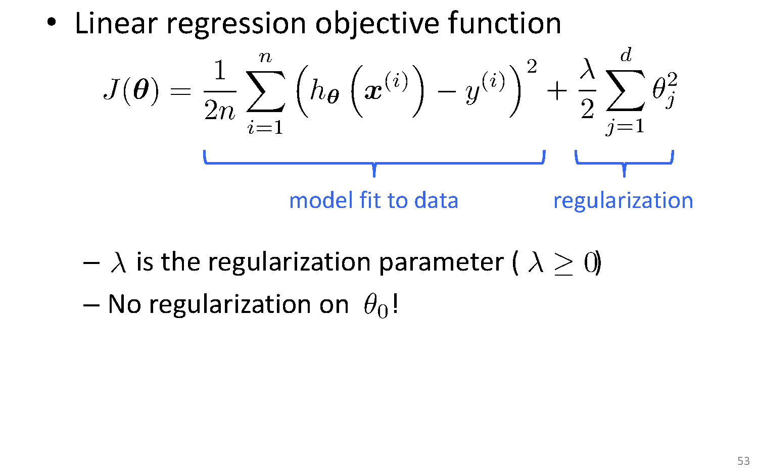
Ridge Regularization

Slide 10
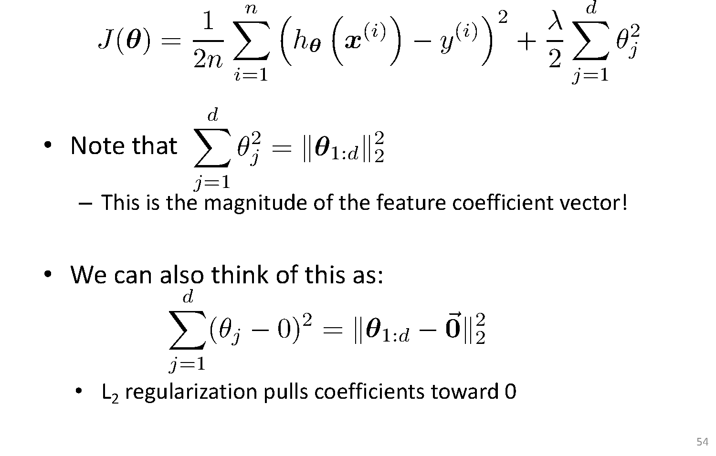
Understanding Regularization

Slide 11
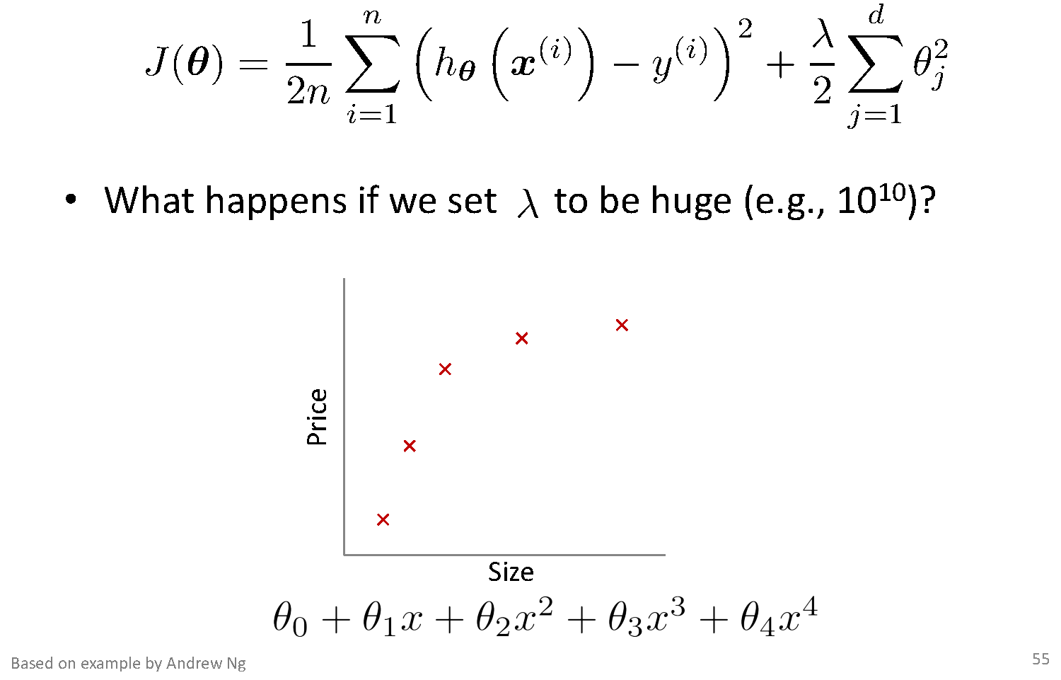
Understanding Regularization

Slide 12
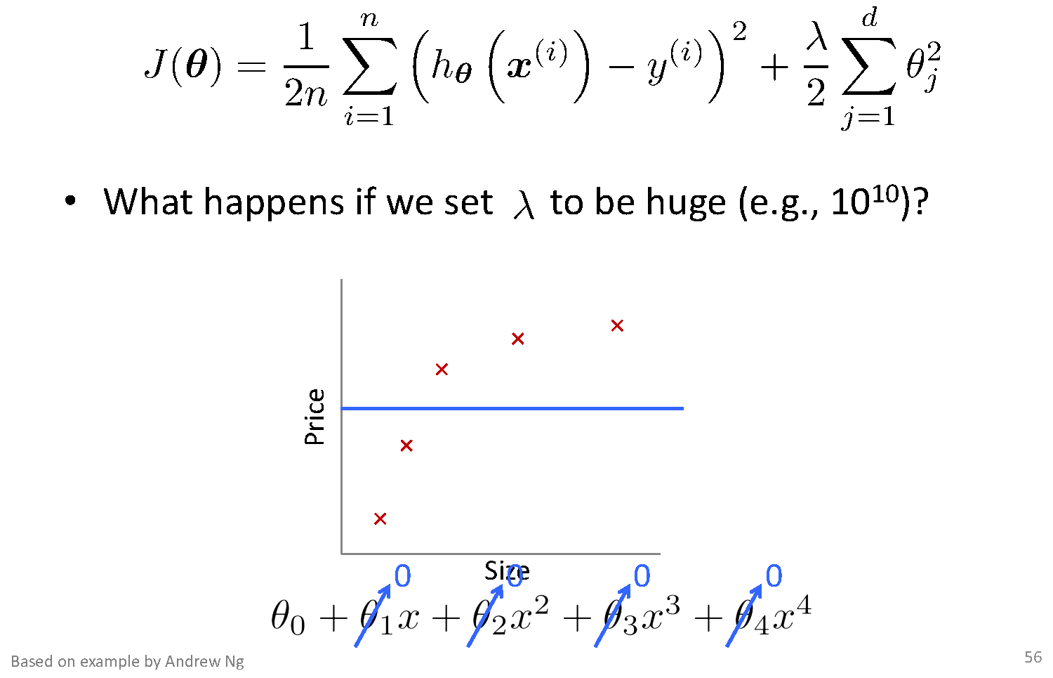
Understanding Regularization

Slide 13
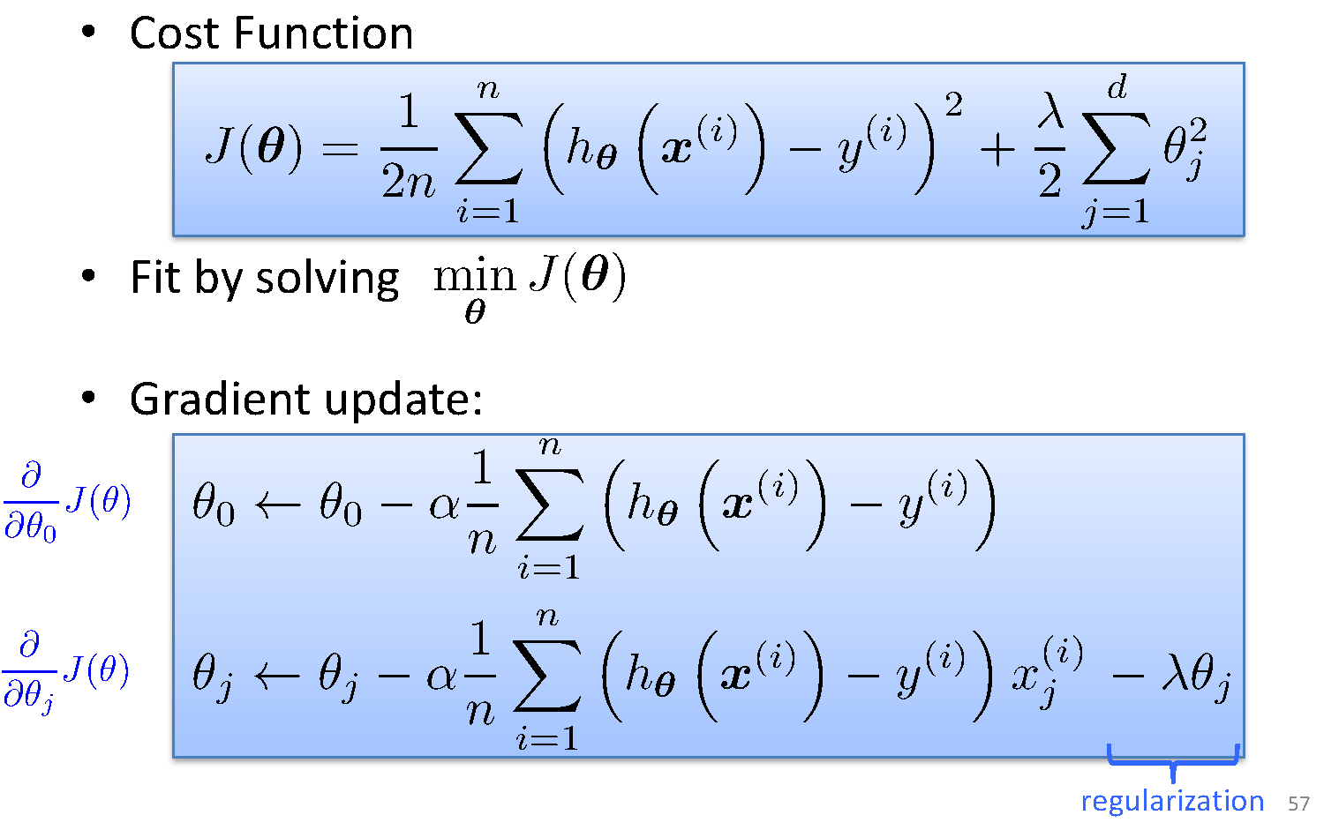
Ridge regression
-αλθ_{j}

Slide 14
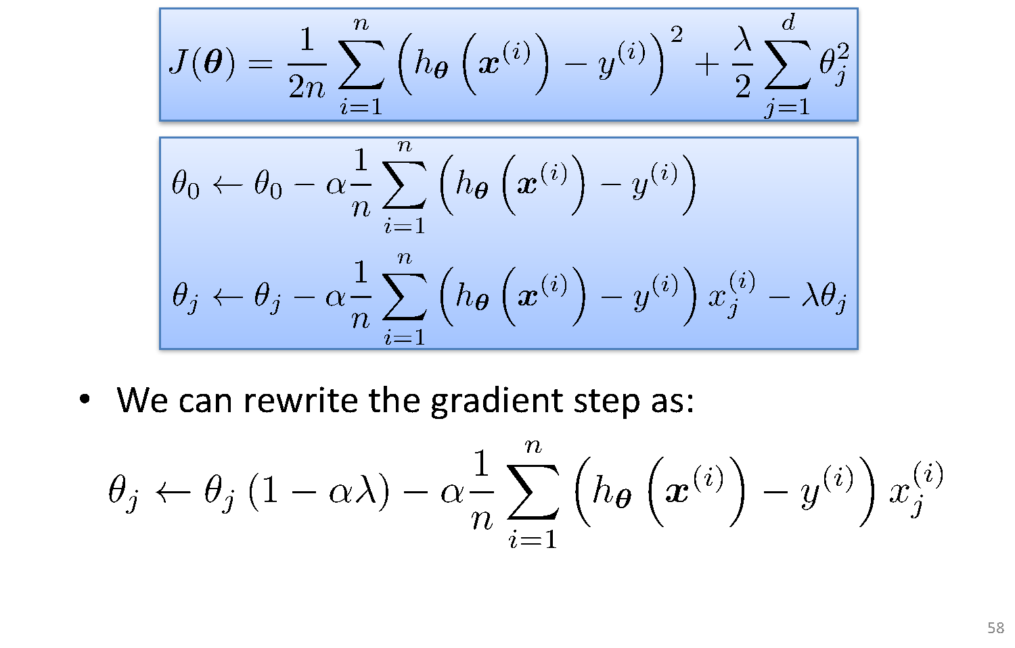
Ridge Regression
-αλθ_{j}

Slide 15
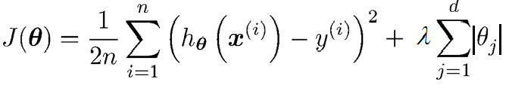
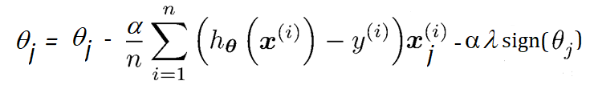
Lasso Regularization

Slide 16
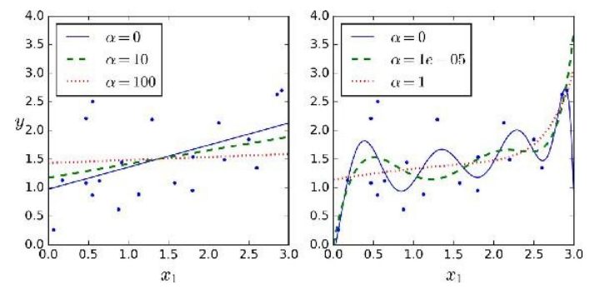
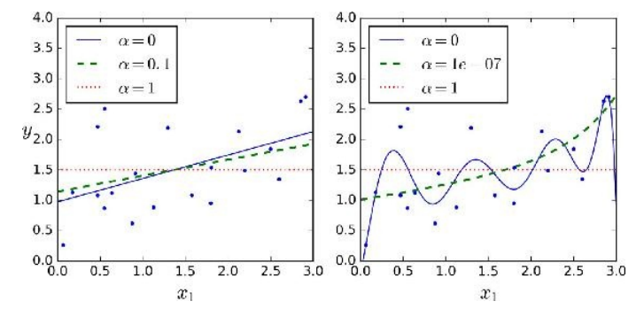
Ridge Vs Lasso Regularization
λ = 0
λ = 0
λ = 10
λ = 10⁻⁵
λ = 100
λ = 1
Lasso
λ = 0
λ = 0
λ = 0.1
λ = 10⁻⁷
λ = 1
λ = 1
λ
Ridge

Slide 17
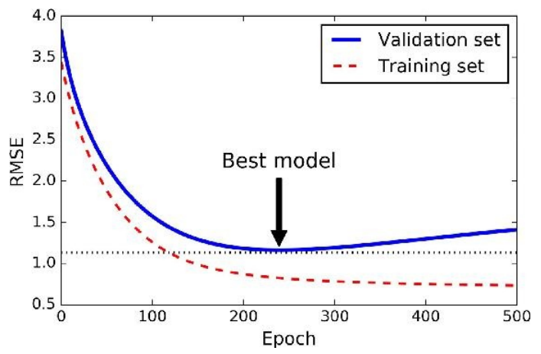
Early Stopping
Do Not Over train to prevent overfitting
Stop training once error on the validation set starts showing an upward trend, even if the error on the training set keeps decreasing

Slide 18
Thank You!
In our next session: Bias Variance Decomposition

Slide 19
Linear Regression Bias Variance Decomposition
Dr. Sugata Ghosal
CSIS Off-Campus Faculty
BITS Pilani

Slide 20
Session Content
What is Bias, Variance
Sources of generalization error
Bias Variance Tradeoff
Bias Variance Decomposition

Slide 21
Bias and Variance
Bias: difference between what you expect to learn (“average” hypothesis) and truth
Measures how well you expect to represent true solution
Decreases with more complex model
Variance: difference between what you expect to learn and what you learn from a particular dataset
Measures how sensitive learner is to specific dataset
Increases with more complex model

Slide 22
Sources of Error
Model’s generalization error can be expressed as the sum of three very different errors
Bias
due to wrong assumptions, such as model order is less than actual order
most likely to underfit the training data.
Variance
Due to model order higher than actual
excessive sensitivity to small variations in the training data.
overfit the training data.
Irreducible error
due to the noisiness of the data itself.
The only way to reduce this error is to clean up the data
Bias Variance Tradeoff
Increasing a model’s complexity will typically increase its variance and reduce its bias.
Conversely, reducing a model’s complexity increases its bias and reduces its variance.

Slide 23
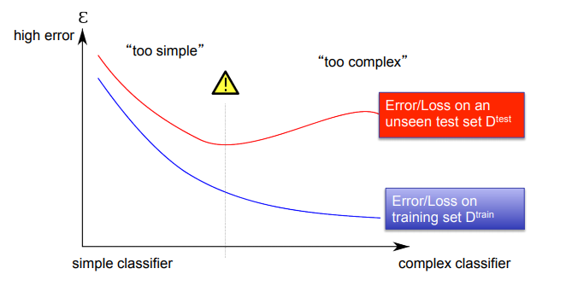
Bias Variance Tradeoff
Bias/Variance is a Way to Understand Overfitting and Underfitting

Slide 24
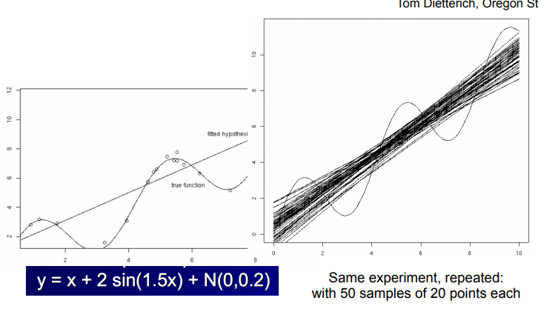
Example with Synthetic Data

Slide 25
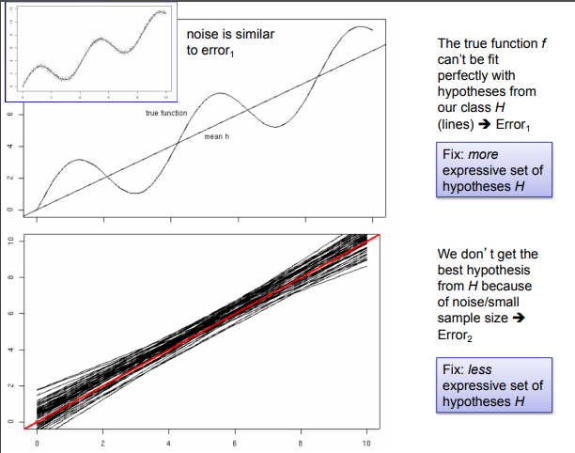
Example

Slide 26
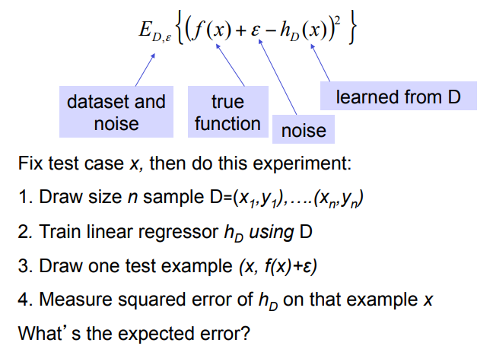
Bias Variance Decomposition

Slide 27
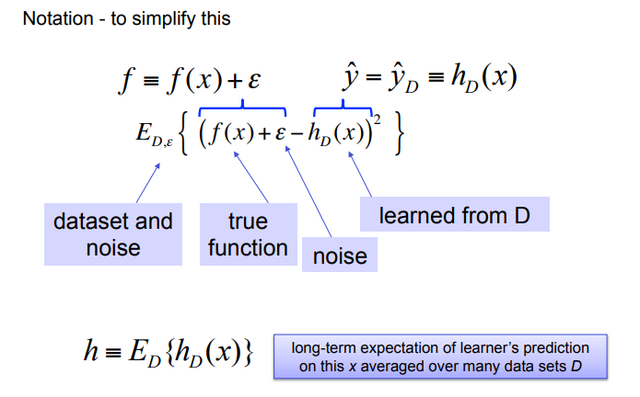
Bias Variance Decomposition

Slide 28
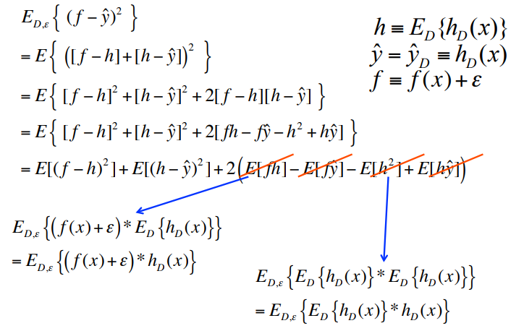
Bias Variance Decomposition

Slide 29
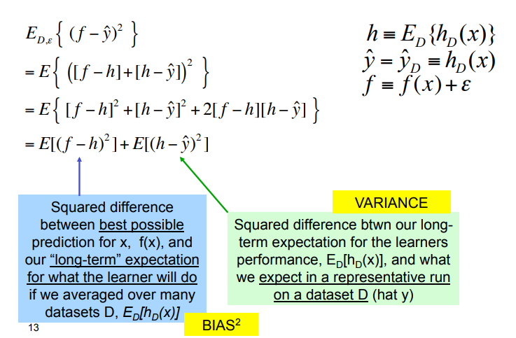
Bias Variance Decomposition

Slide 30
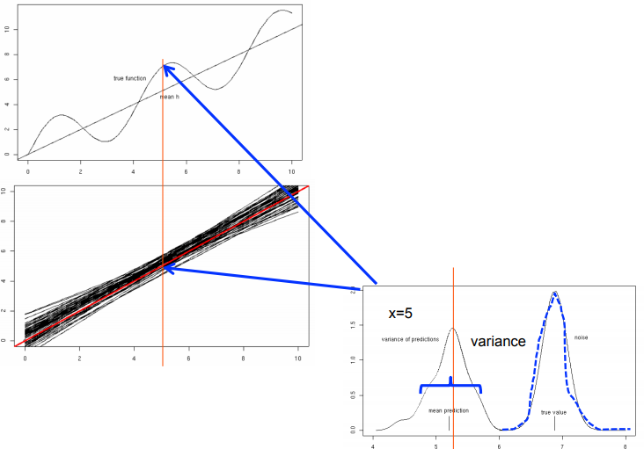
Bias Variance Decomposition
Variance of prediction
noise
True prediction
True value
4 5 6 7 8
bias

Slide 31
Thank You!
In our next session: Classification Models

Slide 32
Classification Model I Introduction
Dr. Sugata Ghosal
CSIS Off-Campus Faculty
BITS Pilani

Slide 33
Segment Content
What is Classification?
Linear Classifier
Generative and Discriminatory Classifier

Slide 34
Classification
Definition
Given a collection of records (training set )
Each record is by characterized by a tuple (x,y), where x is the attribute (feature) set and y is the class label
x aka attribute, predictor, independent variable, input
Y aka class, response, dependent variable, output
Task
Learn a model or function that maps each attribute set x into one of the predefined class labels y
Task | Attribute set, x | Class label, y
Categorizing email messages | Features extracted from email message header and content | spam or non-spam
Identifying tumor cells | Features extracted from x-rays or MRI scans | malignant or benign cells
Cataloging galaxies | Features extracted from telescope images | Elliptical, spiral, or irregular-shaped galaxies

Slide 35
General Approach for Building Classification Model

Slide 36
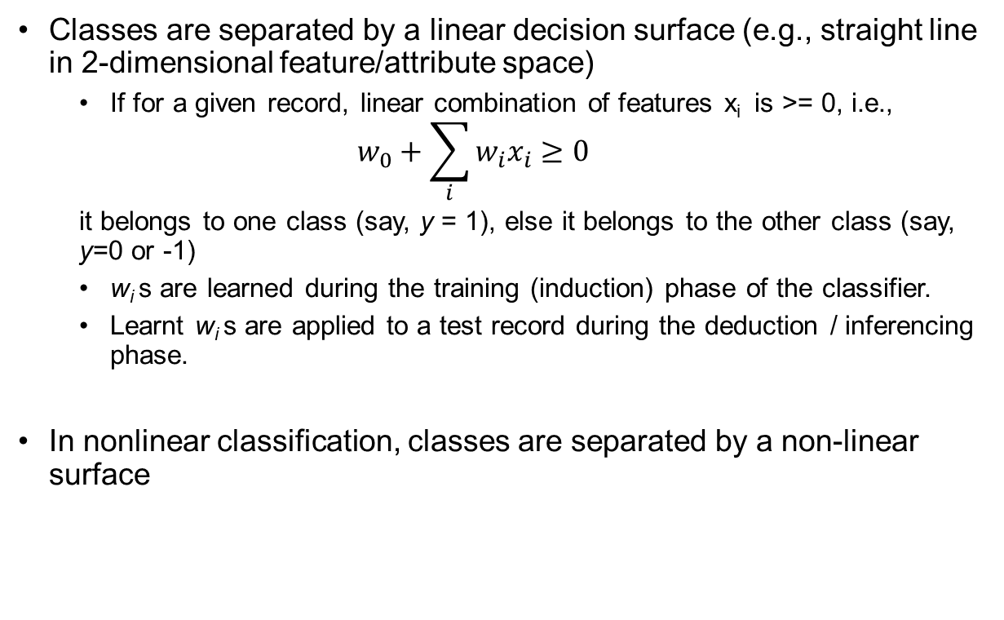
Types of Classifiers
Linear Classifier
Classes are separated by a linear decision surface (e.g., straight line in 2-dimensional feature/attribute space)
If for a given record, linear combination of features x_{i} is >= 0, i.e.,
$$w_{0}+\sum_{i}{{w_{i}x}_{i}≥0}$$
it belongs to one class (say, y = 1), else it belongs to the other class (say, y=0 or -1)
w_{i} s are learned during the training (induction) phase of the classifier.
Learnt w_{i} s are applied to a test record during the deduction / inferencing phase.
In nonlinear classification, classes are separated by a non-linear surface
y=1
x₂
Decision Boundary
y=0
x₁

Slide 37
Generative Vs. Discriminative Models
Generative
Generative Model
Class-conditional probability distribution of attribute/feature set and prior probability of classes are learnt during the training phase
Given these learnt probabilities, during inferencing phase, probability of a test record belonging to different classes are calculated and compared.
Can result in linear or nonlinear decision surface
x₂
x₁
Discriminative
Discriminative Model
y=1
Given a training set, a function f is learnt that directly maps an attribute/feature vector x to the output class (y=1 or 0/-1)
A linear function f results in linear decision surface
x₂
Decision Boundary
y=0
x₁

Slide 38
Thank You!
In our next segement: Naïve Bayes Classifier

Slide 39
Classification Model I Naïve Bayes Classifier
Dr. Sugata Ghosal
CSIS Off-Campus Faculty
BITS Pilani

Slide 40
Segment Content
What is Bayes Classifier?
Bayes Theorem and its application in classification
Conditional Independence and Naïve Bayes Classifier
Laplace Smoothing
Applications of Naïve Bayes Classification
Text classification
Image classification

Slide 41
Bayes Classifier
A generative framework for solving classification problems
Conditional Probability:
Bayes theorem:

Slide 42
Using Bayes Theorem for Classification
Consider each attribute and class label as random variables
Given a record with attributes (X₁, X₂,…, X_{d})
Goal is to predict class Y (“Evade”)
given (X₁,X₂,X₃)=(<Refund>, <Marital Status>, <Taxable Income>)
Specifically, we want to find the value of Y that maximizes P(Y| X₁, X₂,…, X_{d} )
Can we estimate P(Y| X₁, X₂,…, X_{d} ) directly from data?

Slide 43
Using Bayes Theorem for Classification
Approach
Compute posterior probability P(Y | X₁, X₂, …, X_{d}) using the Bayes theorem
Maximum a-posteriori: Choose Y that maximizes P(Y | X₁, X₂, …, X_{d})
Equivalent to choosing value of Y that maximizes P(X₁, X₂, …, X_{d}|Y) P(Y)
How to estimate P(X₁, X₂, …, X_{d} | Y )?

Slide 44
Example Data
Given a Test Record
Can we estimate P(Evade = Yes | X) and P(Evade = No | X)?

Slide 45
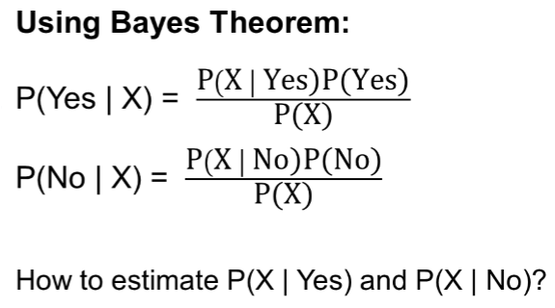
Example Data
Given a Test Record

Slide 46
Conditional Independence
Definition
X and Y are conditionally independent given Z if P(X|YZ) = P(X|Z)
Example: Arm length and reading skills
Young child has shorter arm length and limited reading skills, compared to adults
If age is fixed, no apparent relationship between arm length and reading skills
Arm length and reading skills are conditionally independent given age

Slide 47
Naïve Bayes Classifier
Assume conditional independence
Among attributes X_{i} when class is given:
P(X₁, X₂, …, X_{d} |Y_{j}) = P(X₁| Y_{j}) P(X₂| Y_{j})… P(X_{d}| Y_{j})
Now we can estimate P(X_{i}| Y_{j}) for all X_{i} and Y_{j} combinations from the training data
New point is classified to Y_{j} if P(Y_{j}) Π P(X_{i}| Y_{j}) is maximal.

Slide 48
Naïve Bayes on Example Data
Given a Test Record
P(X | Yes) =
P(Refund = No | Yes) x
P(Divorced | Yes) x
P(Income = 120K | Yes)
P(X | No) =
P(Refund = No | No) x
P(Divorced | No) x
P(Income = 120K | No)

Slide 49
Estimate Probabilities from Data
Discrete Attributes
P(y) = fraction of instances of class y
e.g., P(No) = 7/10, P(Yes) = 3/10
For categorical attributes P(X_{i} =c | y) = n_{c} / n
n_{c} is number of instances having attribute value X_{i} =c and belonging to class y
e.g., P(Status=Married|y=No) = 4/7,
P(Refund=Yes|y=Yes)=0

Slide 50
Estimate Probabilities from Data
Continuous Attributes
Discretization
Partition the range into bins
Replace continuous value with bin value
Attribute changed from continuous to ordinal
Probability density estimation
Assume attribute follows a normal distribution
Use data to estimate parameters of distribution (e.g., mean and standard deviation)
Once probability distribution is known, use it to estimate the conditional probability P(X_{i}|Y)

Slide 51
Estimate Probabilities from Data
Normal Distribution
One for each (X_{i},Y_{i}) pair
For (Income, Class=No)
If Class=No
sample mean = 110
sample variance = 2975

Slide 52
Example of Naïve Bayes Classifier
Given a Test Record
P(Refund = Yes | No) = 3/7
P(Refund = No | No) = 4/7
P(Refund = Yes | Yes) = 0
P(Refund = No | Yes) = 1
P(Marital Status = Single | No) = 2/7
P(Marital Status = Divorced | No) = 1/7
P(Marital Status = Married | No) = 4/7
P(Marital Status = Single | Yes) = 2/3
P(Marital Status = Divorced | Yes) = 1/3
P(Marital Status = Married | Yes) = 0
For Taxable Income:
If class = No: sample mean = 110
sample variance = 2975
If class = Yes: sample mean = 90
sample variance = 25
P(X | No) = P(Refund=No | No) × P(Divorced | No) × P(Income=120K | No) = 4/7 × 1/7 × 0.0072 = 0.0006
P(X | Yes) = P(Refund=No | Yes) × P(Divorced | Yes) × P(Income=120K | Yes) = 1 × 1/3 × 1.2 × 10⁻⁹ = 4 × 10⁻¹⁰
P(X|No)P(No) > P(X|Yes)P(Yes)
Therefore, P(No|X) > P(Yes|X) => Class = No

Slide 53
Naïve Bayes Classifier can make decisions with partial information about attributes in the test record
Use A priori probabilities of class variable
P(Refund = Yes | No) = 3/7
P(Refund = No | No) = 4/7
P(Refund = Yes | Yes) = 0
P(Refund = No | Yes) = 1
P(Marital Status = Single | No) = 2/7
P(Marital Status = Divorced | No) = 1/7
P(Marital Status = Married | No) = 4/7
P(Marital Status = Single | Yes) = 2/3
P(Marital Status = Divorced | Yes) = 1/3
P(Marital Status = Married | Yes) = 0
For Taxable Income:
If class = No: sample mean = 110
sample variance = 2975
If class = Yes: sample mean = 90
sample variance = 25
P(Yes) = 3/10 P(No) = 7/10
If we only know that marital status is Divorced, then:
P(Yes | Divorced) = 1/3 x 3/10 / P(Divorced)
P(No | Divorced) = 1/7 x 7/10 / P(Divorced)
If we also know that Refund = No, then
P(Yes | Refund = No, Divorced) = 1 x 1/3 x 3/10 / P(Divorced, Refund = No)
P(No | Refund = No, Divorced) = 4/7 x 1/7 x 7/10 / P(Divorced, Refund = No)
If we also know that Taxable Income = 120, then
P(Yes | Refund = No, Divorced, Income = 120) =1.2 x10⁻⁹ x 1 x 1/3 x 3/10 /
P(Divorced, Refund = No, Income = 120 )
P(No | Refund = No, Divorced Income = 120) = =0.0072 x 4/7 x 1/7 x 7/10 /
P(Divorced, Refund = No, Income = 120)

Slide 54
Issues with Naïve Bayes Classifier
Given a Test Record
X = (Married)
P(Refund = Yes | No) = 3/7
P(Refund = No | No) = 4/7
P(Refund = Yes | Yes) = 0
P(Refund = No | Yes) = 1
P(Marital Status = Single | No) = 2/7
P(Marital Status = Divorced | No) = 1/7
P(Marital Status = Married | No) = 4/7
P(Marital Status = Single | Yes) = 2/3
P(Marital Status = Divorced | Yes) = 1/3
P(Marital Status = Married | Yes) = 0
For Taxable Income:
If class = No: sample mean = 110
sample variance = 2975
If class = Yes: sample mean = 90
sample variance = 25
P(Yes) = 3/10
P(No) = 7/10
P(Yes | Married) = 0 x 3/10 / P(Married)
P(No | Married) = 4/7 x 7/10 / P(Married)

Slide 55
Issues with Naïve Bayes Classifier
Consider the table with Tid = 7 deleted
P(Refund = Yes | No) = 2/6
P(Refund = No | No) = 4/6
P(Refund = Yes | Yes) = 0
P(Refund = No | Yes) = 1
P(Marital Status = Single | No) = 2/6
P(Marital Status = Divorced | No) = 0
P(Marital Status = Married | No) = 4/6
P(Marital Status = Single | Yes) = 2/3
P(Marital Status = Divorced | Yes) = 1/3
P(Marital Status = Married | Yes) = 0/3
For Taxable Income:
If class = No: sample mean = 91
sample variance = 685
If class = No: sample mean = 90
sample variance = 25
X
X
Given X = (Refund = Yes, Divorced, 120K)
P(X | No) = 2/6 X 0 X 0.0083 = 0
P(X | Yes) = 0 X 1/3 X 1.2 X 10⁻⁹ = 0
Naïve Bayes will not be able to classify X as Yes or No!

Slide 56
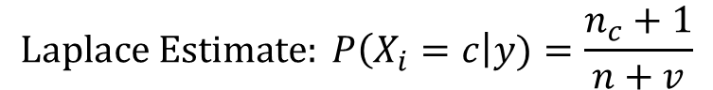
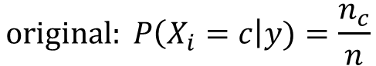
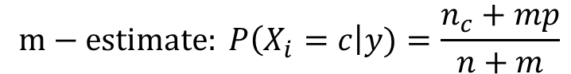
Issues with Naïve Bayes Classifier
If one of the conditional probabilities is zero, then the entire expression becomes zero
Need to use other estimates of conditional probabilities than simple fractions
Probability estimation:
n: number of training instances belonging to class y
n_{c}: number of instances with X_{i} = c and Y = y
v: total number of attribute values that X_{i} can take
p: initial estimate of (P(X_{i} = c|y) known apriori
m: hyper-parameter for our confidence in p
$$original: P\left(X_{i}=c\right|y)=\frac{n_{c}}{n}$$
$$Laplace Estimate: P\left(X_{i}=c\right|y)=\frac{n_{c}+1}{n+v}$$
$$m−estimate: P\left(X_{i}=c\right|y)=\frac{n_{c}+mp}{n+m}$$

Slide 57
Example of Naïve Bayes Classifier
A: attributes
M: mammals
N: non-mammals
P(A|M)P(M) > P(A|N)P(N)
=> Mammals

Slide 58
Thank You!
In our next segment: Applications in Text and Image

Slide 59
Classification Model I Naïve Bayes Applications
Dr. Sugata Ghosal
CSIS Off-Campus Faculty
BITS Pilani

Slide 60
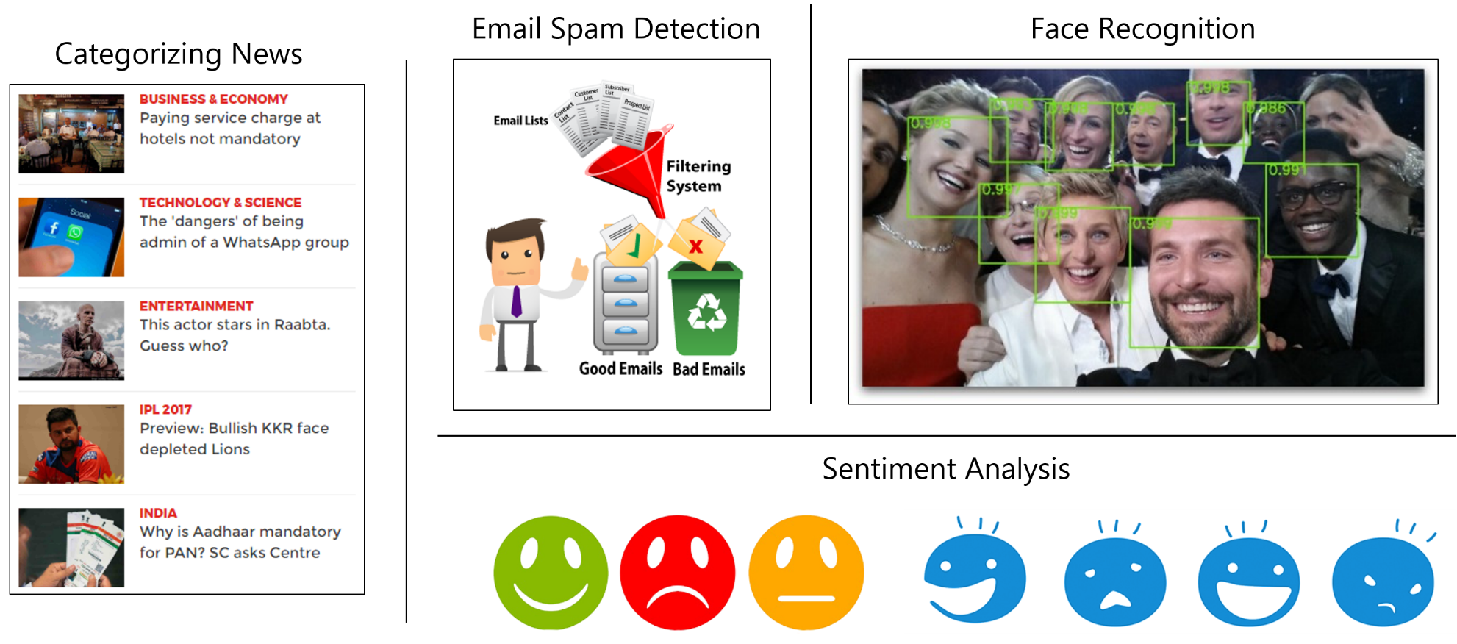
Naïve Bayes Classifier Applications

Slide 61

Baseline: Bag of Words Approach
aardvark 0
about 2
all 2
Africa 1
apple 0
anxious 0
...
gas
...
oil
… Zaire
1
1
0

Slide 62
Learning to Classify Text
Why?
Learn which news articles are of interest
Learn to classify web pages by topic
Naive Bayes is among most effective algorithms
What attributes should we use to represent text documents?

Slide 63
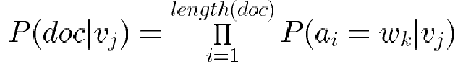
Learning to Classify Text (2/4)
Target concept Interesting? : Document →{ +, − }
Represent each document by vector of words
one attribute per word position in document
Learning: Use training examples to estimate
P(+) − P(−)
P(doc|+) − P(doc|−)
Naive Bayes conditional independence assumption
where P(a_{i} = w_{k} | v_{j}) is probability that word in position i is w_{k}, given v_{j}
One more assumption

Slide 64
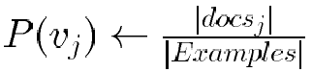
Learning to Classify Text (3/4)
LEARN_NAIVE_BAYES_TEXT (Examples, V)
Collect all words and other tokens that occur in Examples
Vocabulary V ← all distinct words and other tokens in Examples
Calculate the required P(v_{j}) and P(w_{k} | v_{j}) probability terms
For each target value v_{j} in V do
docs_{j} ← subset of Examples for which the target value is v_{j}
Text_{j} ← a single document created by concatenating all members of docs_{j}

Slide 65
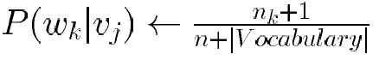
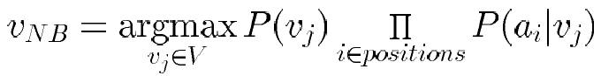
Learning to Classify Text (4/4)
CLASSIFY_NAIVE_BAYES_TEXT (Doc)
n ← total number of words in Text_{j} (counting duplicate words multiple times)
for each word w_{k} in Vocabulary
* n_{k} ← number of times word w_{k} occurs in Text_{j}
positions ← all word positions in Doc that contain tokens found in Vocabulary
Return v_{NB} where

Slide 66
Text Classification: A Simple Example
Text | Tag
“A great game” | Sports
“The election was over” | Not sports
“Very clean match” | Sports
“A clean but forgettable game” | Sports
“It was a close election” | Not sports
Which tag does the sentence A very close game belong to? i.e. P(sports| A very close game)
Feature Engineering: Bag of words i.e., use word frequencies without considering order
Using Bayes Theorem:
P(sports| A very close game)
= P(A very close game| sports) P(sports)
-------------------------------------------------------------
P(A very close game)
We assume that every word in a sentence is independent of the other ones
“close” doesn’t appear in sentences of sports tag, So P(close | sports) = 0, which makes product 0

Slide 67
Laplace smoothing
Laplace smoothing: we add 1 or in general constant k to every count so it’s never zero.
To balance this, we add the number of possible words to the divisor, so the division will never be greater than 1
In our case, the 14 possible words are
{a,great,very,over,it,but,game,election,clean,close,the,was,forgettable,match}

Slide 68
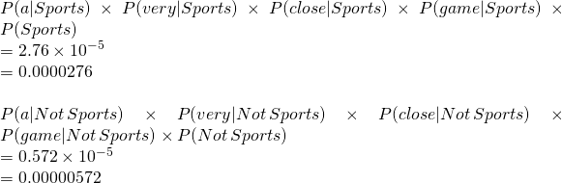
Apply Laplace Smoothing
Word | P(word | Sports) | P(word | Not Sports)
a | 2+1 / 11+14 | 1+1 / 9+14
very | 1+1 / 11+14 | 0+1 / 9+14
close | 0+1 / 11+14 | 1+1 / 9+14
game | 2+1 / 11+14 | 0+1 / 9+14

Slide 69
Experiment with NewsGroups
Given 1000 training documents from each group Learn to classify new documents according to which newsgroup it came from
Naive Bayes: 89% classification accuracy
comp.graphics comp.os.ms-windows.misc comp.sys.ibm.pc.hardware comp.sys.mac.hardware comp.windows.x | misc.forsale rec.autos rec.motorcycles rec.sport.baseball rec.sport.hockey | alt.atheism soc.religion.christian talk.religion.misc talk.politics.mideast talk.politics.misc talk.politics.guns | sci.space sci.crypt sci.electronics sci.med

Slide 70
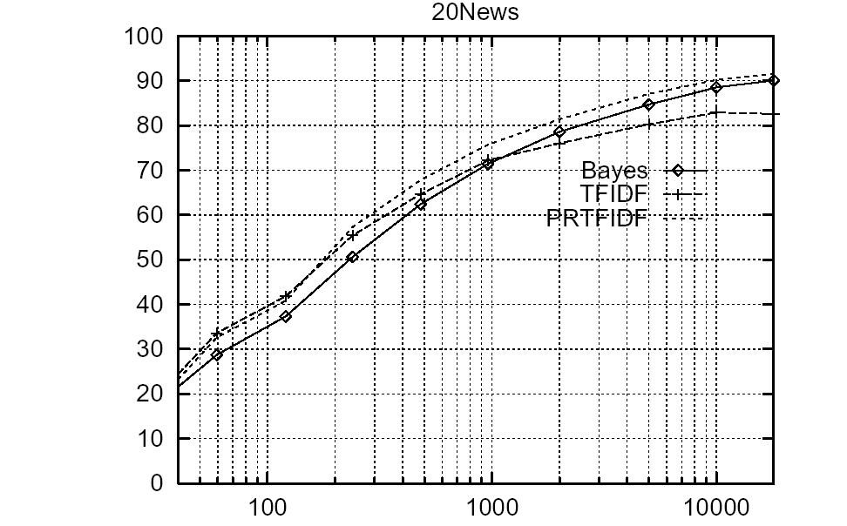
Learning Curve for Newsgroups
Accuracy vs. Training set size
1/3 withheld for test

Slide 71
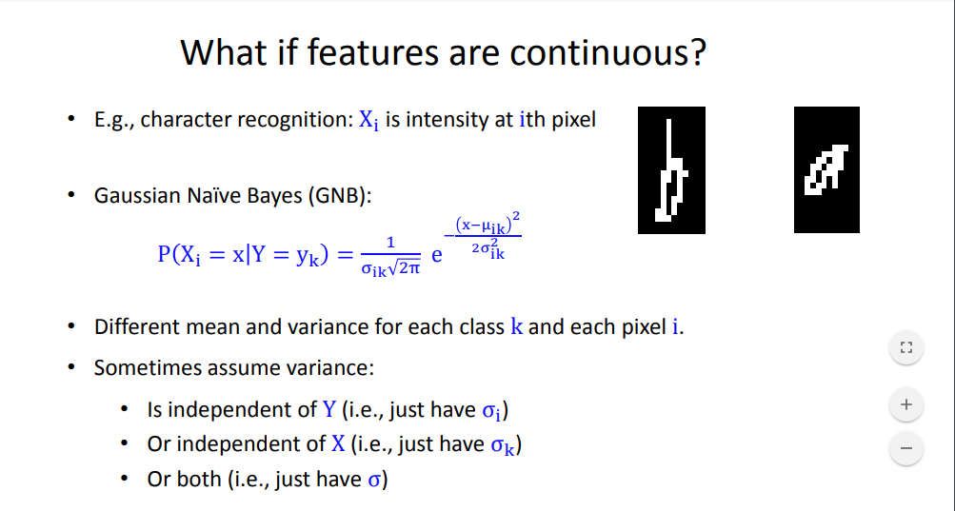
Image Classification
Example: Character Recognition
X_{i} is intensity at i-th pixel
Given a test image X, calculate Probability P(Y=y_{k} | X) = P(y_{k}) Π_{i} P(X_{i} | y_{k}) for all k

Slide 72
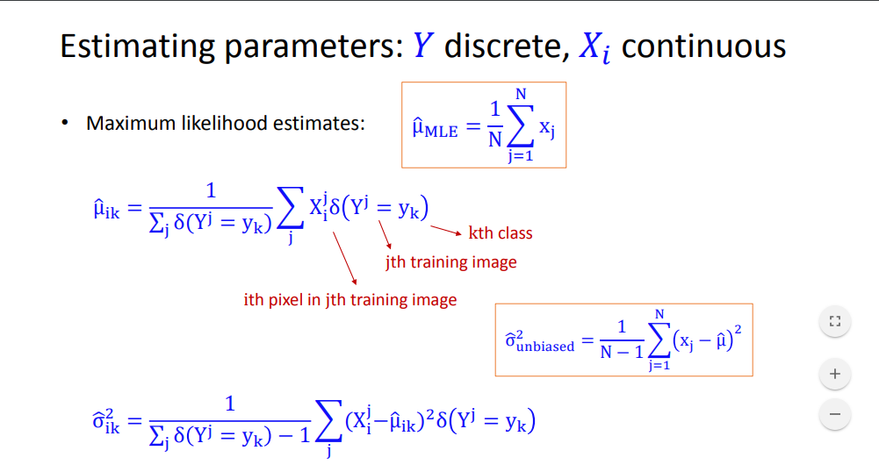
Example: Character Recognition
Estimating parameters: Y discrete, X_{i} continuous
δ(k) is Kronecker’s delta – equals 1 if argument is true

Slide 73
Thank You!
In our next segment: Logistic Regression

Slide 74
Classification Model I Logistic Regression
Dr. Sugata Ghosal
CSIS Off-Campus Faculty
BITS Pilani

Slide 75
Segment Content
What is Logistic Regression?
Sigmoid function
Log loss Cost Function
Optimization Using Gradient Descent
Regularization
Multi-class classification

Slide 76
Logistic regression
Logistic Regression could help use predict, for example, whether the student passed or failed. Logistic regression predictions are discrete (only specific values or categories are allowed). We can also view probability scores underlying the model’s classifications.
In comparison, Linear Regression could help us predict the student’s test score on a scale of 0 - 100. Linear regression predictions are continuous (numbers in a range).
Idea
Naïve Bayes allows computing P(Y|X) by learning P(Y) and P(X|Y)
Why not learn P(Y|X) directly?

Slide 77
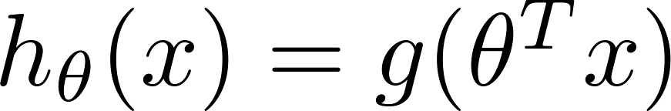

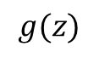
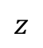
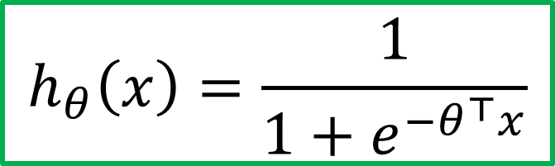
Sigmoid/Logistic Function
Classification requires discrete output values
For example, output y = 0 or 1 for a two-category classification problem
In logistic regression, sigmoid/logistic function h_{ɵ}(x) takes a real vector x as input and outputs a value between 0 and 1
ɵ is a vector of logistic regression parameters
$$h_{θ}\left(x\right)=\frac{1}{1+e^{−θ^{⊤}x}}$$
$$g(z)$$
$$z$$

Slide 78
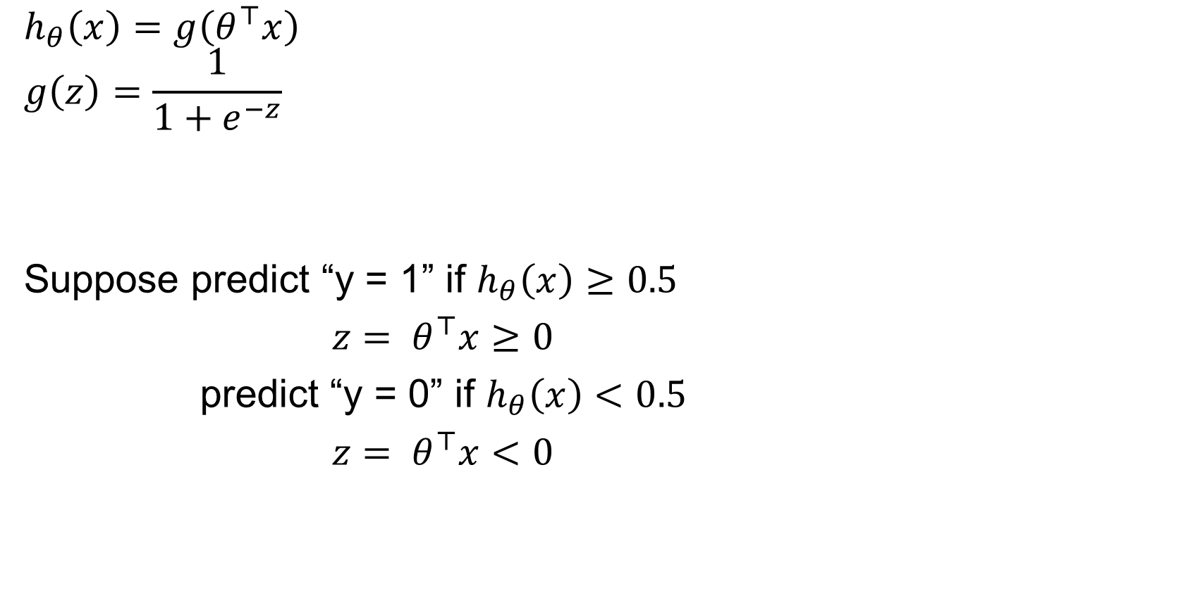
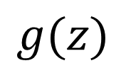
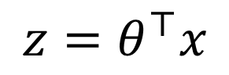
Logistic regression
$$h_{θ}\left(x\right)=g\left(θ^{⊤}x\right)$$
$$g\left(z\right)=\frac{1}{1+e^{−z}}$$
Suppose predict “y = 1” if $h_{θ}\left(x\right)≥0.5$
${z= θ}^{⊤}x≥0$
predict “y = 0” if $h_{θ}\left(x\right)<0.5$
${z= θ}^{⊤}x<0$
$$g(z)$$
$$z=θ^{⊤}x$$

Slide 79
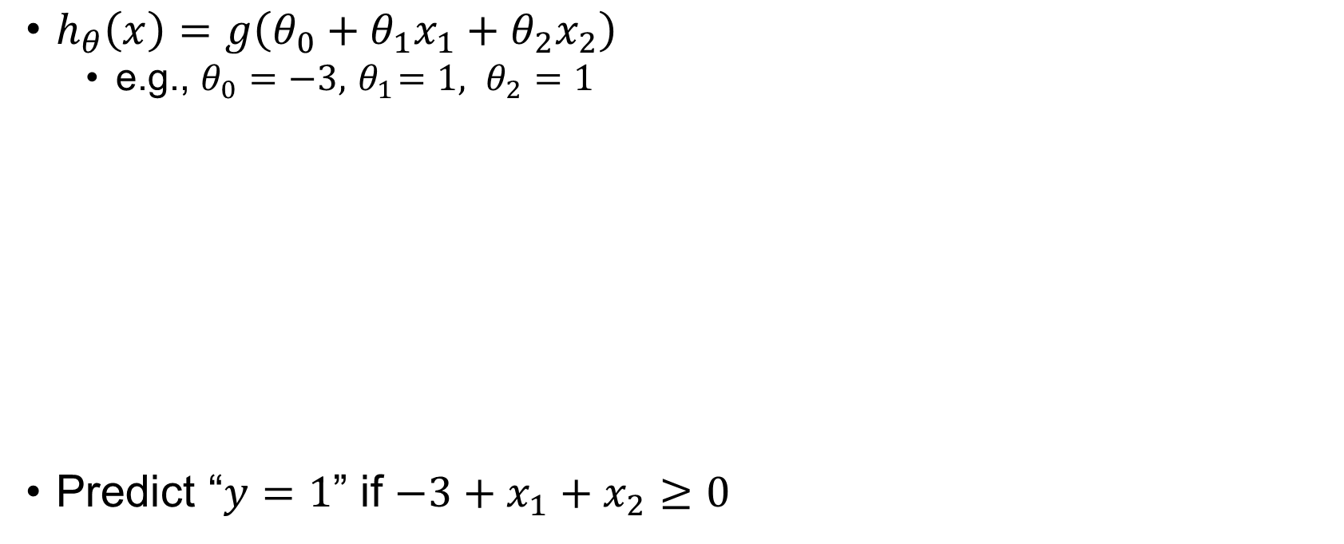
Decision boundary
At decision boundary output of logistic regressor is 0.5
$h_{θ}\left(x\right)=g\left(θ_{0}+θ_{1}x_{1}+θ_{2}x_{2}\right)$
e.g., $θ_{0}=−3, { θ}_{1}=1, θ_{2}=1$
Predict “$y=1$” if $−3+x_{1}+x_{2}≥0$
Decision boundary
Age
Tumor Size

Slide 80
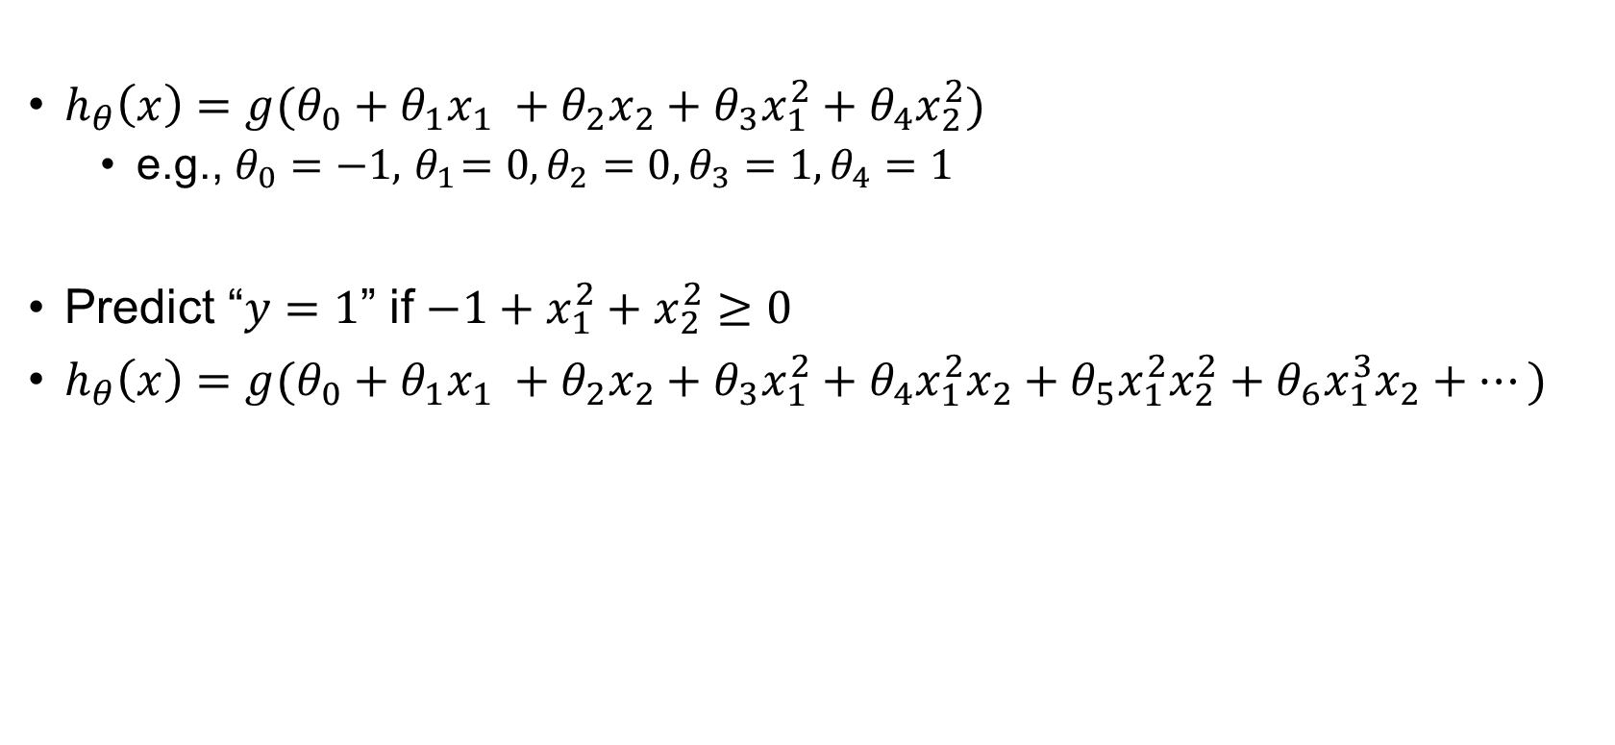
$h_{θ}\left(x\right)=g(θ_{0}+θ_{1}x_{1} +θ_{2}x_{2}+$ $θ_{3}x_{1}^{2}+θ_{4}x_{2}^{2})$
e.g., $θ_{0}=−1, { θ}_{1}=0, θ_{2}=0,θ_{3}=1, θ_{4}=1$
Predict “$y=1$” if $−1+x_{1}^{2}+x_{2}^{2}≥0$
$h_{θ}\left(x\right)=g(θ_{0}+θ_{1}x_{1} +θ_{2}x_{2}+$ $θ_{3}x_{1}^{2}+θ_{4}x_{1}^{2}x_{2}+θ_{5}x_{1}^{2}x_{2}^{2}+θ_{6}x_{1}^{3}x_{2}+⋯)$

Slide 81
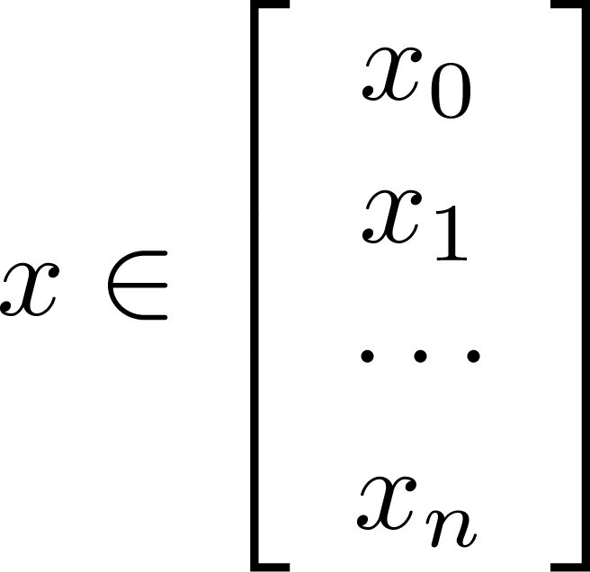



Learning Model Parameters
Training set:
m examples
n features
How to choose parameters (feature weights)?

Slide 82


MSE Cost Function
MSE cost function is non convex for logistic regression due to sigmoidal function
Logistic regression:
“non-convex”
“convex”
Gradient descent may not find the optimal global minimum.
So instead of Mean Squared Error, use a error/ cost function called Cross-Entropy, also known as Log Loss.

Slide 83








Cost function for Logistic Regression
Cross Entropy or Log Loss Function
$$if y=1$$
$$Cost(h_{θ}\left(x\right),y)=\left\{\begin{aligned}−log\left(h_{θ}\left(x\right)\right) if y=1 \\ −log\left({1−h}_{θ}\left(x\right)\right) if y=0\end{aligned}\right.$$
$$0$$
$$h_{θ}\left(x\right)$$
$$1$$
$Cost\left(h_{θ}\left(x\right),y\right)=−y log\left(h_{θ}\left(x\right)\right)−(1−y)$ $log\left({1−h}_{θ}\left(x\right)\right)$
$$if y=0$$
J(θ) is convex
Apply gradient descent on J(θ) w.r.t. θ to find optimal parameters
$$h_{θ}\left(x\right)$$
$$1$$
$$0$$

Slide 84



Gradient descent
$$J\left(θ\right)=−\frac{1}{m}\left[\sum_{i=1}^{m}{y^{(i)} log\left(h_{θ}\left(x^{(i)}\right)\right)+(1−y^{(i)}) log\left({1−h}_{θ}\left(x^{(i)}\right)\right)}\right]$$
Goal: $\min_{θ}{J(θ)}$
Repeat {
$$θ_{j}≔θ_{j}−α\frac{∂}{∂θ_{j}}J\left(θ\right)$$
}
Good news: Convex function!
Bad news: No analytical solution
(Simultaneously update all $θ_{j}$)
$$\frac{∂}{∂θ_{j}}J\left(θ\right)=\frac{1}{m}\sum_{i=1}^{m}{(h_{θ}\left(x^{\left(i\right)}\right)−y^{(i)})}x_{j}^{(i)}$$

Slide 85


Regularization of Logistic Regression
Maximum a posteriori estimate of W = θ
λ is “regularization” constant
helps reduce overfitting
keep weights nearer to zero

Slide 86


Logistic regression more generally
Logistic regression when Y not boolean (but still discrete-valued).
Now y ∈ {y₁ ... y_{R}} : learn R-1 sets of weights
For k<R
For k=R

Slide 87




Multi-class classification
Binary classification
Multiclass classification
$$x_{2}$$
$$x_{2}$$
$$x_{1}$$
$$x_{1}$$

Slide 88












One-vs-all (one-vs-rest)
$$x_{2}$$
$$h_{θ}^{\left(1\right)}\left(x\right)$$
$$x_{1}$$
$$x_{2}$$
$$x_{2}$$
$$h_{θ}^{\left(2\right)}\left(x\right)$$
$$x_{1}$$
$$x_{1}$$
Class 1:
Class 2:
Class 3:
$$h_{θ}^{\left(3\right)}\left(x\right)$$
$$x_{2}$$
$$h_{θ}^{\left(i\right)}\left(x\right)=P\left(y=i | x;θ\right) (i=1, 2, 3)$$
$$x_{1}$$

Slide 89

One-vs-all
Train a logistic regression classifier $h_{θ}^{\left(i\right)}\left(x\right)$ for each class $i$ to predict the probability that $y=i$
Given a new input $x$, pick the class $i$that maximizes
$\max_{i}$ $h_{θ}^{\left(i\right)}\left(x\right)$

Slide 90
Logistic Regression Applications
Credit Card Fraud : Predicting if a given credit card transaction is fraud or not
Health : Predicting if a given mass of tissue is benign or malignant
Marketing : Predicting if a given user will buy an insurance product or not
Banking : Predicting if a customer will default on a loan.

Slide 91
Thank You!
In our next segment: Support Vector Machine

Slide 92
Classification Model I Support Vector Machines
Dr. Sugata Ghosal
CSIS Off-Campus Faculty
BITS Pilani

Slide 93
Session Content
Introduction
Support Vectors
Linear Support Vector Machine
Maximizing Margin
Handling non linearly separable data
Non-linear Classification
Kernel Functions

Slide 94
Support Vector Machines
Find a linear hyperplane (decision boundary) that will separate the data

Slide 95
Support Vector Machines
One Possible Solution

Slide 96
Support Vector Machines
Another possible solution

Slide 97
Support Vector Machines
Other possible solutions

Slide 98
Support Vector Machines
Which one is better? B1 or B2?
How do you define better?

Slide 99
Support Vector Machines
Find hyperplane maximizes the margin
=> B1 is better than B2

Slide 100
Support Vector Machines

Slide 101
Linear SVM
Linear Model
Learning the model is equivalent to determining the values of
How to find from training data?

Slide 102

Learning Linear SVM
$$y_{i}(w•x_{i}+b)≥1, i=1,2,...,N$$
Objective is to maximize:
Which is equivalent to minimizing:
Subject to the following constraints:
or
This is a constrained optimization problem
Solve it using Lagrange multiplier method
Lagrange multipliers λ_{i} are 0 or +ve
L(w, b, λ_{i})= $\frac{1}{2}$ ||w||² - Σ λ_{i} [y_{i} (w^{T}x_{i} + b) -1]

Slide 103

Learning Linear SVM
λ _{i}
λ_{i} is non-zero except for support vectors
λ _{i}

Slide 104
Example of Linear SVM
Support vectors

Slide 105
Learning Linear SVM
Decision boundary depends only on support vectors
If you have data set with same support vectors, decision boundary will not change
How to classify using SVM once w and b are found? Given a test record, x_{i}

Slide 106
Support Vector Machines
What if the problem is not linearly separable?

Slide 107
Support Vector Machines
What if the problem is not linearly separable?
Introduce slack variables
Need to minimize
subject to
If k is 1 or 2, this leads to similar objective function as linear SVM but with different constraints

Slide 108
Support Vector Machines
Find the hyperplane that optimizes both factors

Slide 109


Nonlinear Support Vector Machines
What if decision boundary is not linear?

Slide 110




Nonlinear Support Vector Machines
Transform data into higher dimensional space
Decision boundary:

Slide 111




Learning Nonlinear SVM
Optimization Problem
which leads to the same set of equations (but involve Φ(x) instead of x)

Slide 112
Learning NonLinear SVM
Issues
What type of mapping function Φ should be used?
How to do the computation in high dimensional space?
Most computations involve dot product Φ(x_{i})• Φ(x_{j})
Curse of dimensionality?

Slide 113

Learning Nonlinear SVM
Kernel Trick:
Φ(x_{i})• Φ(x_{j}) = K(x_{i}, x_{j})
K(x_{i}, x_{j}) is a kernel function (expressed in terms of the coordinates in the original space)
Examples:

Slide 114

Example of Nonlinear SVM
SVM with polynomial degree 2 kernel

Slide 115
Learning Nonlinear SVM
Advantages of using kernel:
Don’t have to know the mapping function Φ
Computing dot product Φ(x_{i})• Φ(x_{j}) in the original space avoids curse of dimensionality
Not all functions can be kernels
Must make sure there is a corresponding Φ in some high-dimensional space
Mercer’s theorem (see textbook)

Slide 116
Summary
Robust to isolated noise points
Handle missing values by ignoring the instance during probability estimate calculations
Robust to irrelevant attributes
Redundant and correlated attributes will violate class conditional assumption

Slide 117
Thank You!
In our next session: Comparison and Applicability

Slide 118
Classification Model I Comparison and Applicability
Dr. Sugata Ghosal
CSIS Off-Campus Faculty
BITS Pilani

Slide 119
Session Content
Pros and Cons
Naïve Bayes Classifier
Logistic Regression
Support Vector Machines

Slide 120
Generative vs. Discriminative Classifiers
Training classifiers involves estimating f: X -> Y, or P(Y|X)
Generative classifiers like Naïve Bayes
Assume some functional form for probabilities P(X|Y), P(X)
Estimate parameters of P(X|Y), P(X) directly from training data
Use Bayes rule to calculate P(Y|X= x_{i})
Discriminative classifiers like Logistic regression, support vector machine
Assume some functional form for f: X -> Y
Estimate parameters of mapping function f directly from training data

Slide 121
Naïve Bayes Generative Model
Naïve Bayes classifier uses likelihood and prior probability to calculate conditional probability of the class
Likelihood is based on joint probability, which is the core principle of probabilistic generative model
Naïve Bayes simplifies the calculation of likelihood by the assumption of conditional independence among input parameters
Each parameter’s likelihood is determined using joint probability of the input parameter and the output label

Slide 122
Naïve Bayes – Advantages
Algorithm is simple to implement and fast
If conditional independence holds, it will converge quickly than other methods
Even in cases where conditional independence doesn’t hold, its results are quite acceptable
Needs less training data (due to conditional independence assumption)
Highly scalable, scales linearly with the number of predictors and training points
Can be used for both binary and multi-class classification problems
Handles continuous and discrete data
Not sensitive to irrelevant features
Doesn’t overfit the data due to small model size (compared to other algorithms like Random Forest)
Handles missing values well

Slide 123
Naïve Bayes – When to use
When the training data is small
When the features are conditionally independent (mostly)
When we have large number of features with minimal data set
Ex: Text classification

Slide 124
Naïve Bayes versus Logistic Regression
Naïve Bayes are Generative Models
Logistic Regression are Discriminative Models
When the training size reaches infinity, logistic regression performs better than the generative model Naive Bayes.

Slide 125
Logistic Regression and Gaussian Naïve Bayes Classifier
Interestingly, the parametric form of P(Y|X) used by Logistic Regression is precisely the form implied by the assumptions of a Gaussian Naive Bayes classiﬁer.
Therefore, we can view Logistic Regression as a closely related alternative to GNB, though the two can produce different results in many cases

Slide 126
Parameter estimation of generic logistic regression
Logistic Regression holds in many problem settings beyond the GNB problem
General method required for estimating it in a more broad range of cases.
In many cases we may suspect the GNB assumptions are not perfectly satisﬁed.
We may wish to estimate the wi parameters directly from the data

Slide 127
Characteristics of SVM
The learning problem is formulated as a convex optimization problem
Efficient algorithms are available to find the global minima
Many of the other methods use greedy approaches and find locally optimal solutions
High computational complexity for building the model
Robust to noise
Overfitting is handled by maximizing the margin of the decision boundary
In some sense, the best linear model for classification.
SVM can handle irrelevant and redundant data better than many other techniques
The user needs to provide the type of kernel function and cost function
Difficult to handle missing values
What about categorical variables?
Needs to be mapped to some metric space
Computationally expensive for large training data with many attributes

Slide 128
Thank You!
In our next session: Classification Model II

